Slide 1
Community Support Group
Coming together to help

Slide 2
Thoughts from CSG folks
"We need to change our thinking about who can make changes happen - it's not just highly placed people.“
"We must be prepared to have the difficult discussions, to risk conflict. Trust is built when we find positive ways to address conflict or different experiences and perspectives."

Slide 3
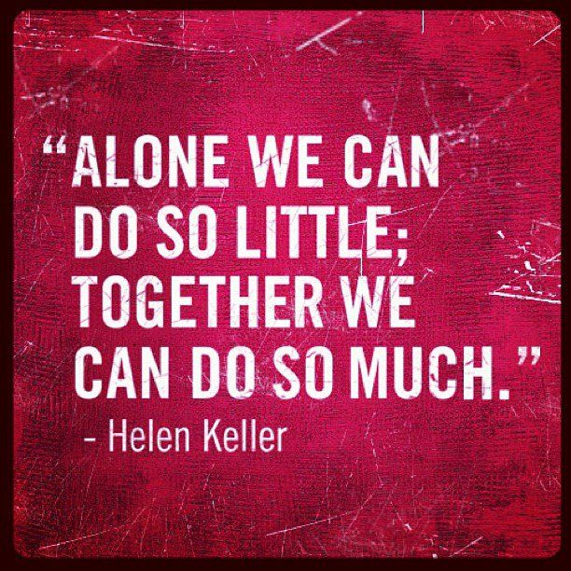
What is a Community Support Group?
Diverse group of concerned community members who come together to create a coordinated community response to adults abuse and neglect.
Notes:
Every little action counts. This is even more true if actions are put together by a group of people.

Slide 4
Community Support Networks
Who are the members of the Community Support Network?
Older adults
Youth
People more personally affected by abuse
People working as caregivers & service providers in government/agencies/NGO’S
Local leadership, territorial leadership
Indigenous and community governments

Slide 5
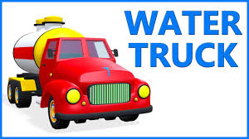
A coordinated community response brings:
Better response to individuals who are abused or neglected
Better coordination of working towards prevention over time
Network is vehicle for doing this
Notes:
A water truck has to know the community. It has to know who needs water and where to go to deliver the water. The community response network helps to make this kind of plan.

Slide 6
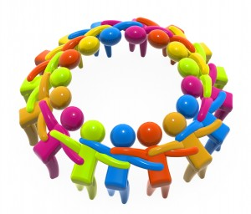
CSGeam sharing power and responsibility
Different sectors (health, social work, RCMP, justice committee, community government, elders, school) work together to give services and support
Community events to educate and help prevent abuse
Support agencies in carrying out their work
Keep track of how our response is working
Notes:
There are different sectors even in small communities. If they come together, the work is better and more helpful. If we talk about elder abuse, we help to prevent it.

Slide 7
Community support networks
Activities of community support network can include
Active Living/healthy ageing initiatives
Family violence and abuse initiatives
Participation in special days such as World Elder Abuse Awareness Day, Family Violence Awareness Week
Setting up buddy systems
Establishing and supporting safe homes
Advocating on behalf of older adults
Protocol agreement development
There is lots that can be done – a community just needs to pick one or two and go for it!!!

Slide 8
What are Protocols and Why are they Important?
Agreements and Commitments covering topics such as
information sharing,
who will do what, when, and
when referrals for help will be made to others
Protocols are formal agreements or commitments between an agency, interagency or any group of individuals who agree to work together to meet the need of the older adult;

Slide 9
Protocol Development A Whole Community Approach
Community
Protocol
Agency
Inter-Agency
Agency
Inter-Agency
Inter-Agency
Agency
Agency
Inter-Agency
Inter-Agency
Inter-Agency
Agency
Agency
Community
Protocol

Slide 10
Community Response Network
Who?
What will you do?
Where will it take place?
Why are you doing it?
When will you do it?

